Slide 1
Assignment for Data Scientist Role
Data-Driven Stock Analysis
Lalit Jadhav
lalitjadhav28@gmail.com
7350875045
Date: 04-04-2025

Slide 2
TABLE OF CONTENT
Assignment Roadmap
Apple Inc.
Dividend Impact
Bonus Shares & Stock-Split Impact
Industry-Wise Stock Benchmarking and Comparison
Volatility Comparison
Performance Benchmarking
Adidas Stock Trade Strategy and comparison with the Buy and Hold Strategy
Summary and Insights

Slide 3
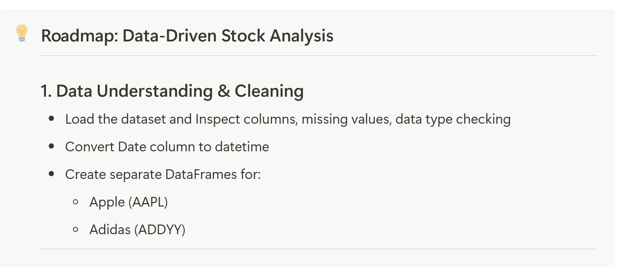
Assignment Roadmap

Slide 4
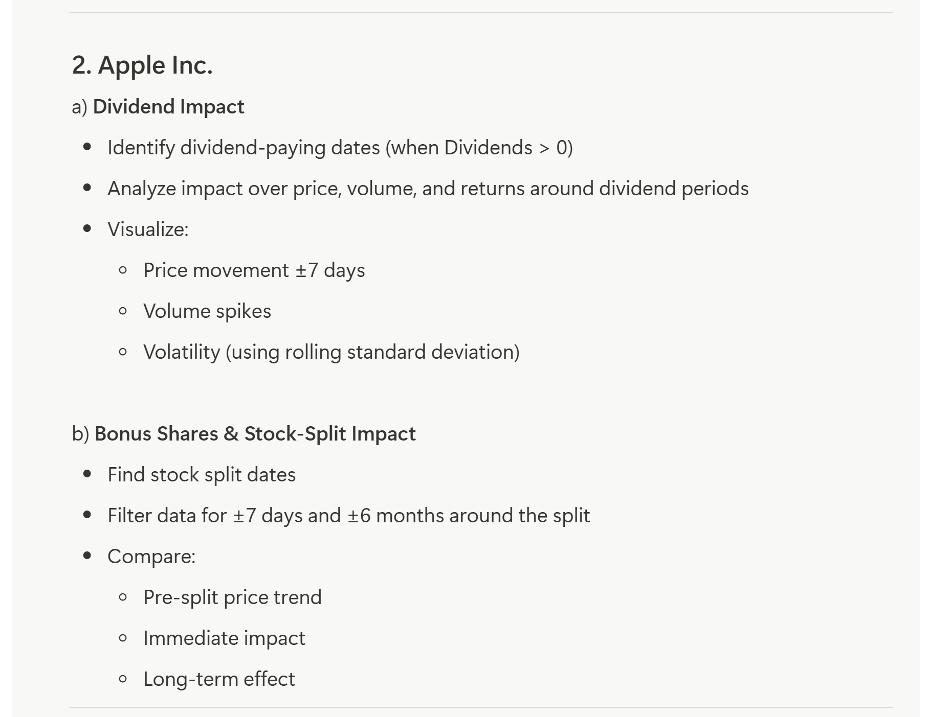

Slide 5
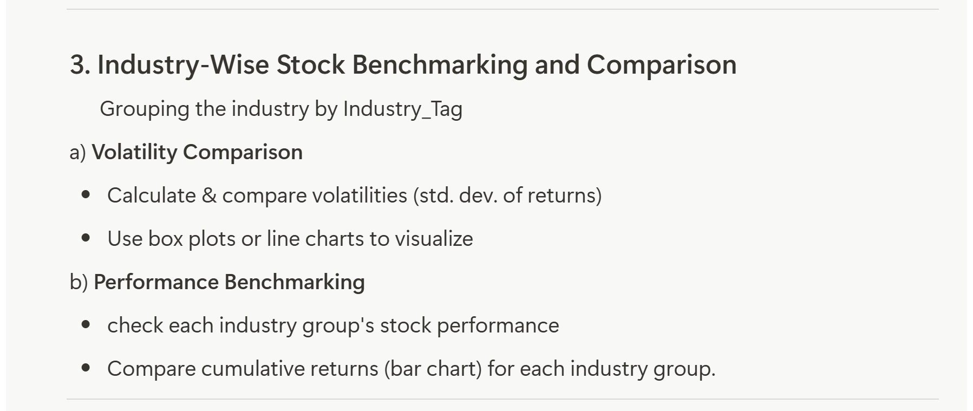

Slide 6
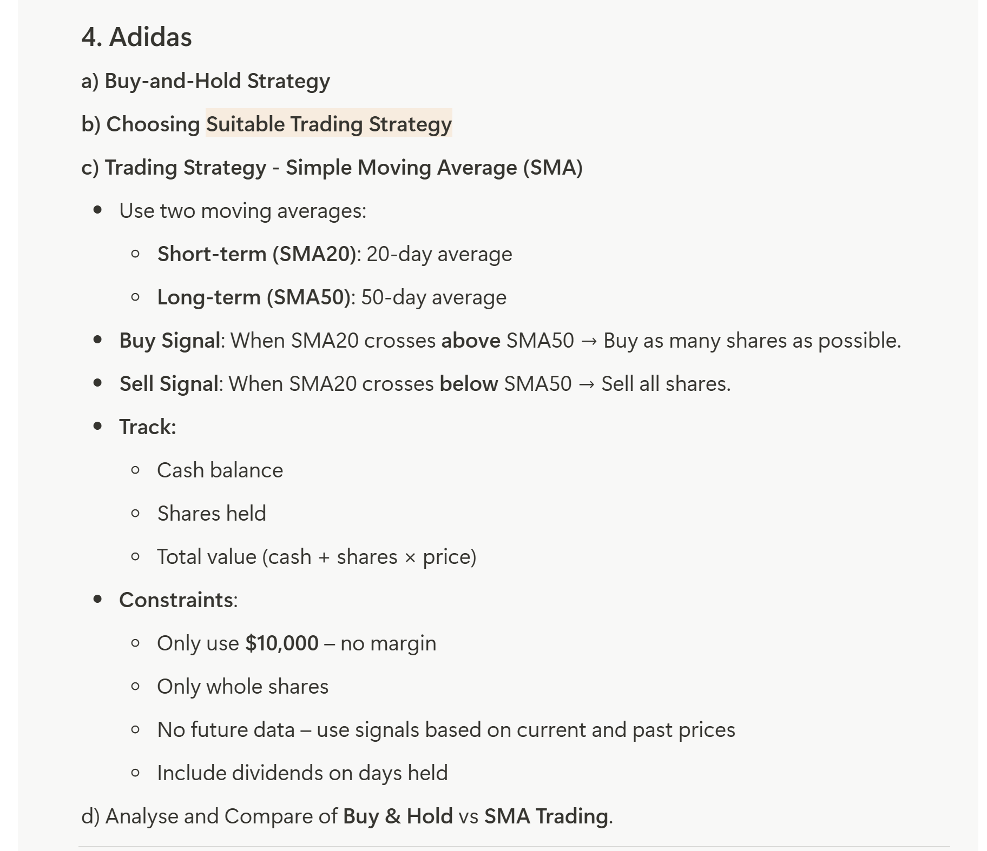

Slide 7
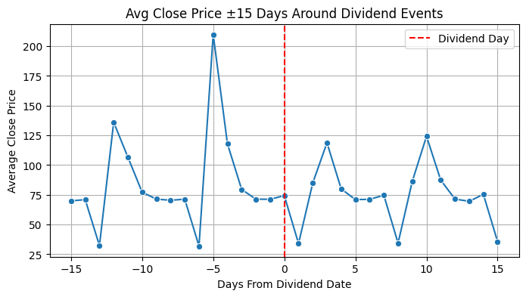
Apple Inc.
A] Dividend Impact:
Here, we have analysed how Apple stock behaves before and after a dividend payout — i.e., changes in price, volume, and volatility around dividend events.
The average closing price shows a noticeable spike shortly before the dividend day, likely due to investors buying in to capture the dividend.
This is followed by a drop post-dividend, possibly reflecting the market adjusting for the payout. The sharp fluctuations suggest heightened investor activity and price volatility around these dates.

Slide 8
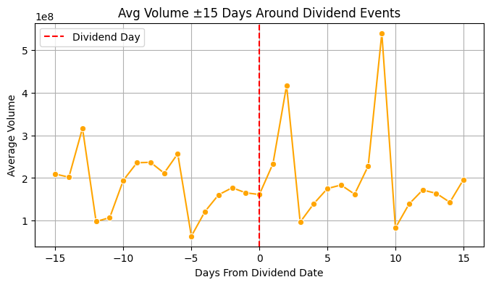
Average Trading Volume:
We observe a surge in average trading volume just after the dividend day, suggesting increased market activity—possibly due to investors reacting to the dividend payout or rebalancing portfolios.
There are also notable volume spikes a few days before and after, indicating heightened investor interest and trading strategy execution during this window

Slide 9
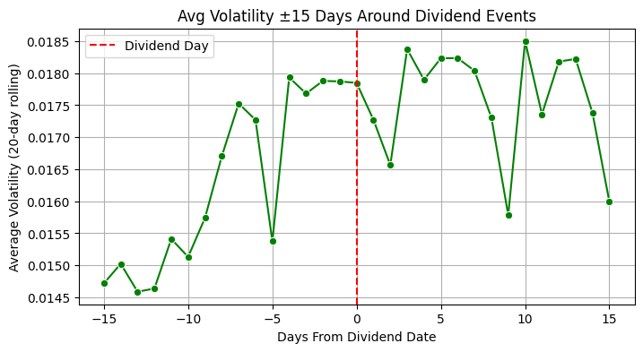
Average Volatility:
The chart shows a noticeable rise in average volatility leading up to the dividend date, likely due to increased investor speculation and trading activity.
However, post-dividend, the volatility begins to decline, suggesting that the market stabilizes after the dividend event. This drop indicates that investor uncertainty is reduced once the dividend is paid out, and trading behavior returns to normal levels.

Slide 10
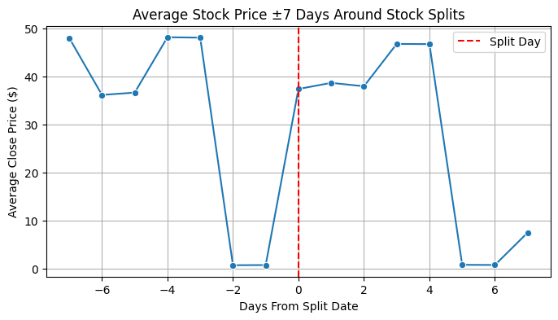
Stock-Split Impact
Short Term Impact:
Pre-split (Days -7 to -1): Prices are relatively high, with some volatility.
On split day (Day 0): The price dips but does not crash, indicating a technical adjustment or market normalization.
Post-split (Days +1 to +7): There's a gradual upward trend, suggesting:
Renewed investor interest post-split.
Increased affordability for retail investors.
Positive sentiment about the stock’s future potential.
The short-term stock price trend around Apple’s stock split events indicates a temporary dip or normalization around the split date, followed by a gradual recovery and upward movement.
This suggests that while the market briefly adjusts for the technical change, investor confidence remains intact or improves post-split, possibly due to increased accessibility and perceived value.

Slide 11
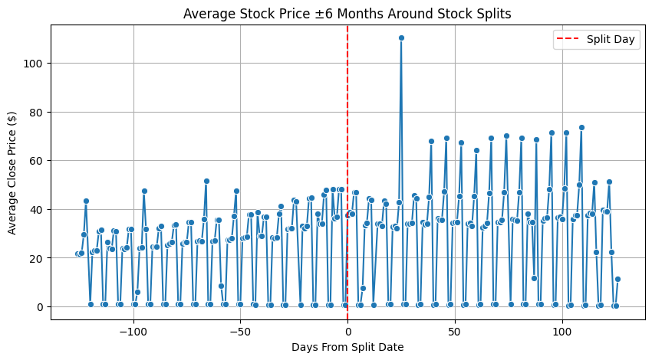
Long Term Impact:
Over the long term, stock prices post-split appear to follow a cyclical pattern of spikes and corrections. This could be attributed to post-split investor enthusiasm followed by profit booking, retail investor behavior, or earnings-related volatility.
The presence of this seasonality suggests that while stock splits generate bullish sentiment initially, investor reactions tend to stabilize before potentially resuming an upward trend driven by fundamentals
Spike: Investors may get excited right after a stock split → more buying → price increases.
Drop: After the hype fades, some investors may book profits → price correction.
Second Spike: Company fundamentals continue to drive the stock up again.

Slide 12
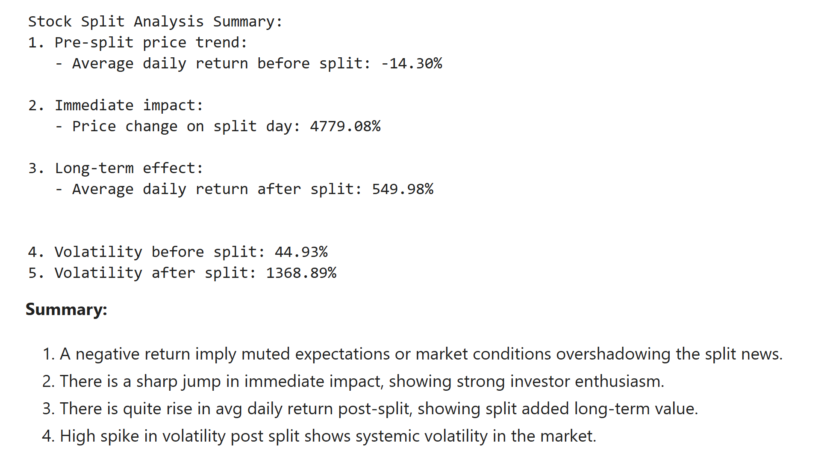
Stock-Split Impact Summary:

Slide 13
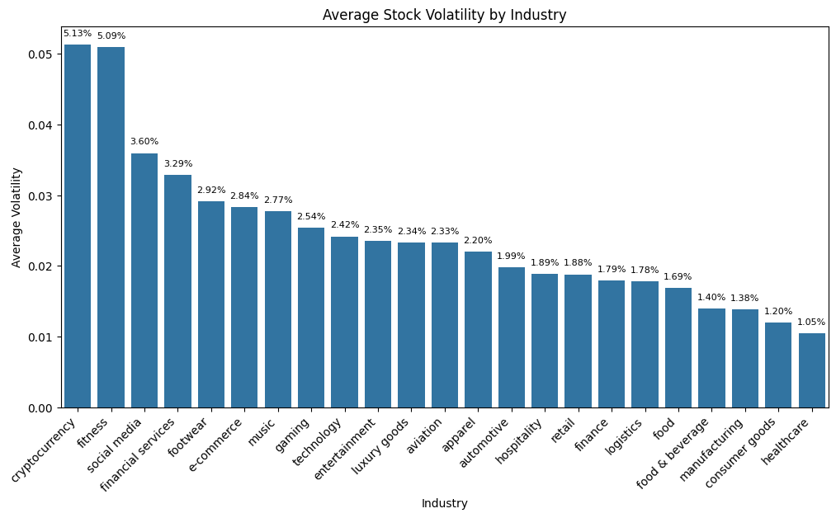
Industry-Wise Stock Benchmarking and Comparison
Volatility Comparison:
High Volatility Industries:
Cryptocurrency (5.13%) and Fitness (5.09%) top the list — indicating these industries experience large price fluctuations.
These sectors are either highly sensitive to market sentiment (crypto, social media) or react strongly to macroeconomic factors (finance, fitness during health trends).
Low Volatility Industries:
Healthcare (1.05%), Consumer Goods (1.20%), and Manufacturing (1.38%) are at the bottom.
These sectors are traditionally considered stable and defensive, meaning they remain relatively unaffected by market fluctuations. Great for risk-averse investors.
Mid-Range Volatility:
Industries like Technology, Gaming, Entertainment, Aviation, etc. fall in the middle — they can go either way depending on global trends, product cycles, or innovation.

Slide 14
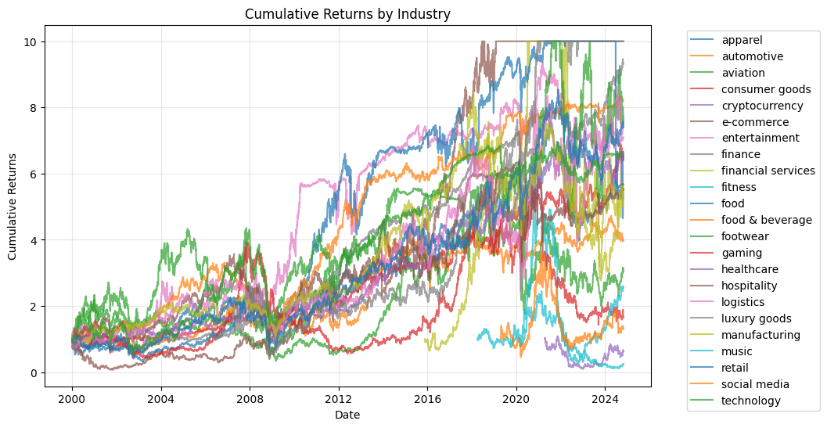
Performance Benchmarking:

Slide 15
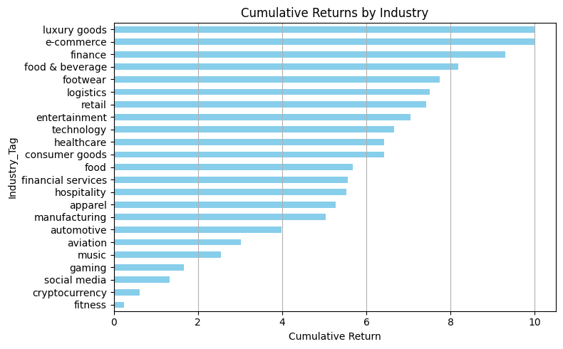
Top Performers:
Luxury goods led all industries with a 10x cumulative return, followed closely by e-commerce (≈9.2x) and finance (≈8.8x).
These industries exhibited strong and sustained growth, reflecting robust consumer demand, digital transformation, and favorable macroeconomic conditions.
Lowest Performers:
Cryptocurrency (~1.2x), fitness (~1.1x), and social media (~1.6x) significantly underperformed.
This underperformance suggests post-pandemic normalization, reduced user engagement, or high volatility without sustained returns.
Industries that fluctuated more weren’t always the best performers. In fact, sectors like luxury goods and finance combined moderate volatility with high compounding, making them attractive from a long-term investment perspective.

Slide 16
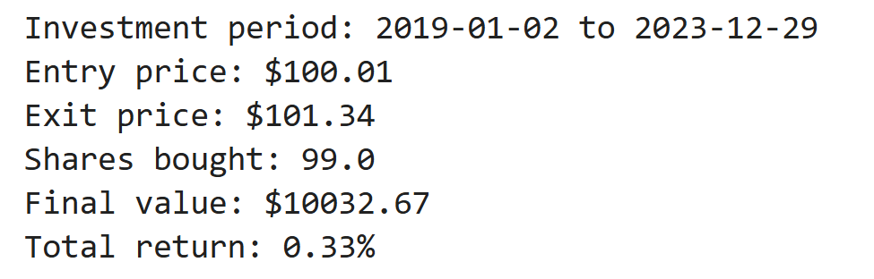
Adidas
A] Buy and Hold Approach:
B] Trading Strategy - Simple Moving Average [SMA-20 and SMA-50]
SMA-based Trading Strategy is a classic trend-following method.
There are other strategies available such as a)RSI-based strategy, b)Bollinger Bands and c)MACD crossovers into considerations but SMA was selected for the analysis because of its simplicity, interpretability, and suitability for analyzing long-term price trends, especially around discrete events like stock splits.
When SMA20 crosses above SMA50 → Buy signal (bullish crossover)
When SMA20 crosses below SMA50 → Sell signal (bearish crossover)

Slide 17
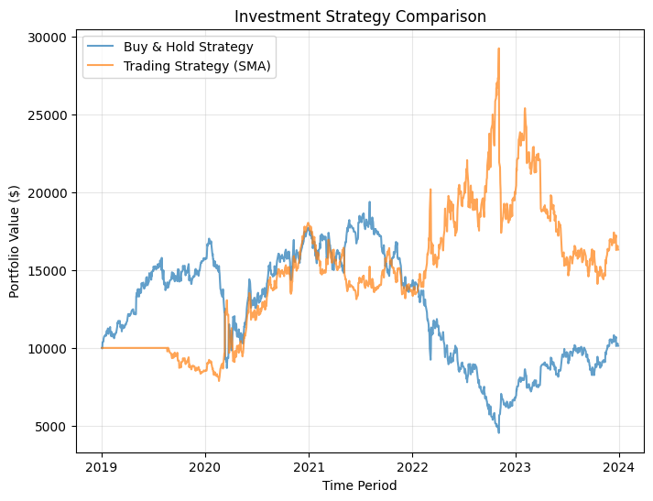
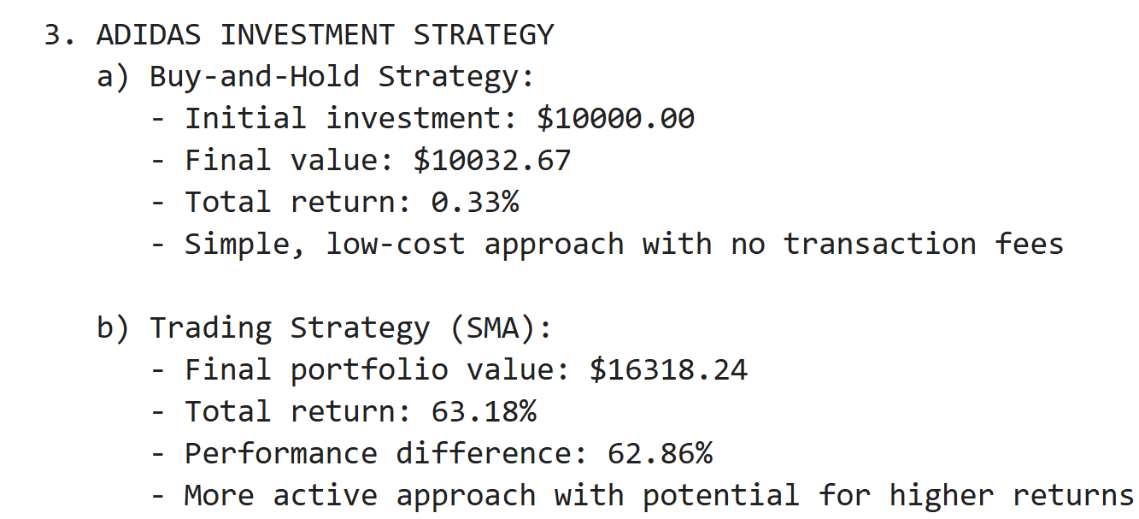
Comparison between both approaches:

Slide 18
THANK YOU!

